Slide 1
CAPSTONE PROJECT -2 NYC TAXI TRIP TIME PREDICTION

Slide 2

Contents
Problem Statement
Introduction
Data Summary
Data Analysis
Challenges
Conclusions

Slide 3
Problem Statement
We have the data which was originally published by the NYC Taxi and Limousine Commission (TLC), for the year 2016. This dataset consists of various trip related features and our aim is to predict the trip duration based on these features.

Slide 4

Introduction
In today’s world it has become a race to gain more and more number of customers.
To gain more number of customers companies/vendors usually try to provide their customers with more comfort to attract them.
So here we will be predicting the time of trip duration our customers will take and which algorithm is best suited for that time prediction.

Slide 5
Data Summary
id - a unique identifier for each trip
vendor_id - a code indicating the provider associated with the trip record
pickup_datetime - date and time when the meter was engaged
dropoff_datetime - date and time when the meter was disengaged
passenger_count - the number of passengers in the vehicle (driver entered value)
pickup_longitude - the longitude where the meter was engaged
pickup_latitude - the latitude where the meter was engaged
dropoff_longitude - the longitude where the meter was disengaged
dropoff_latitude - the latitude where the meter was disengaged
store_and_fwd_flag - This flag indicates whether the trip record was held in vehicle memory before sending to the vendor because the vehicle did not have a connection to the server - Y=store and forward; N=not a store and forward trip
trip_duration - duration of the trip in seconds (Dependent variable)

Slide 6
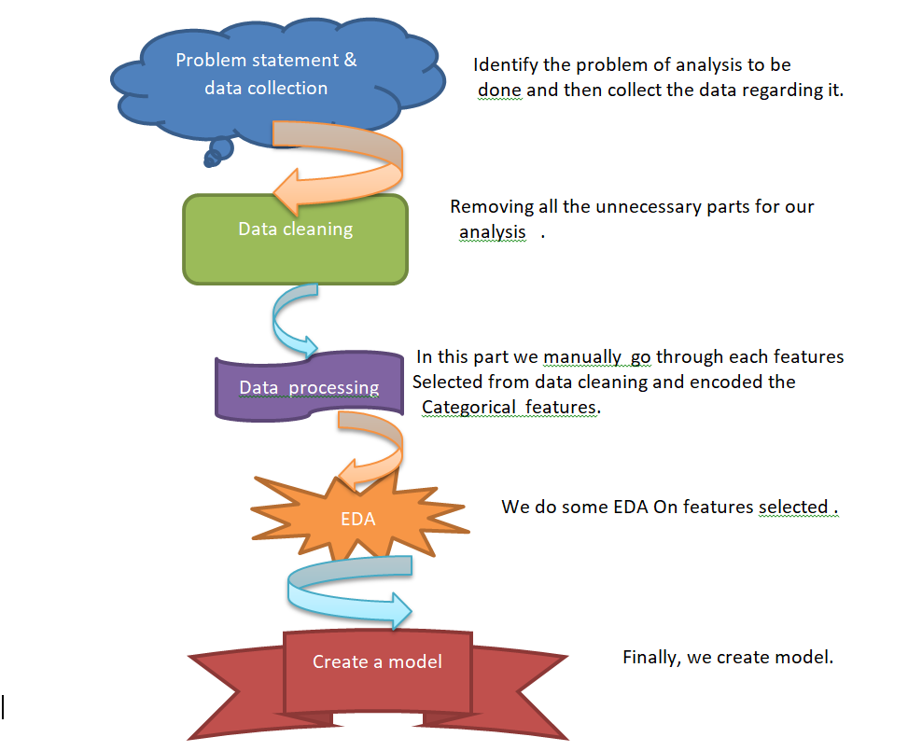
DATA PIPELINE

Slide 7
Basic Exploration
The dataset contains 1458644 rows and 11 features(columns)
Two categorical features ‘store_and_fwd_flag’ and ‘vendor_id’ are there.
Outliers present in all numerical features.
Data cleaning steps required for datetime features.
Thankfully ,there are no null values present in our dataset .

Slide 8
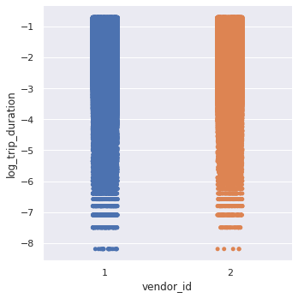
Vendor ID Analysis
we observe that vendor 1 mostly provides
short duration cabs while vendor 2
provides cab for both short & long
duration.

Slide 9
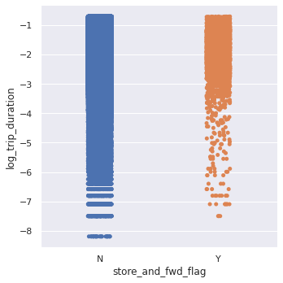
Store and Forward flag

Slide 10
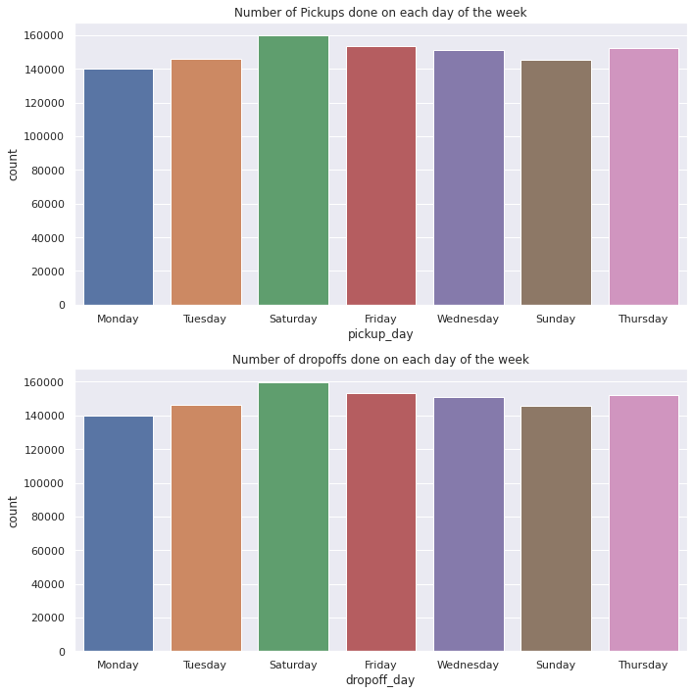
Days of the week

Slide 11
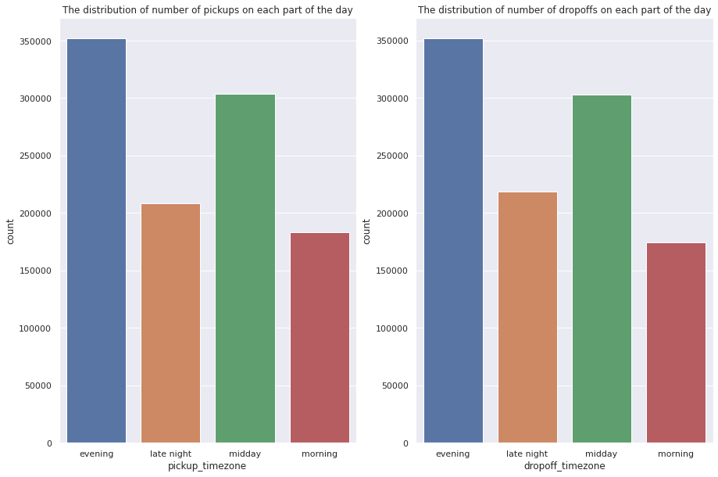
Day segmentation

Slide 12
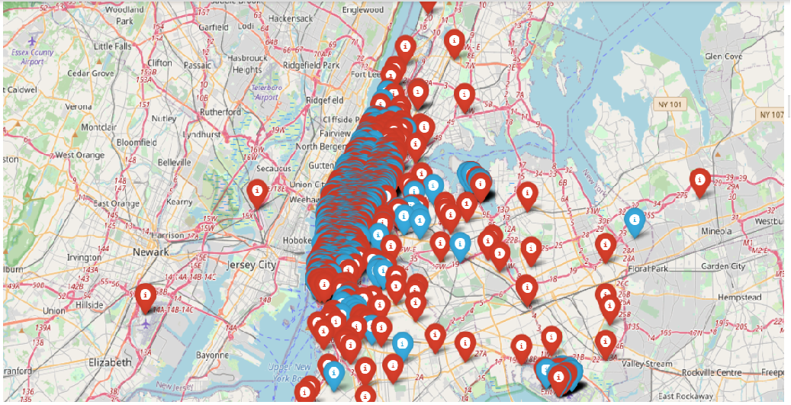
Plotting Latitide & Longitude

Slide 13
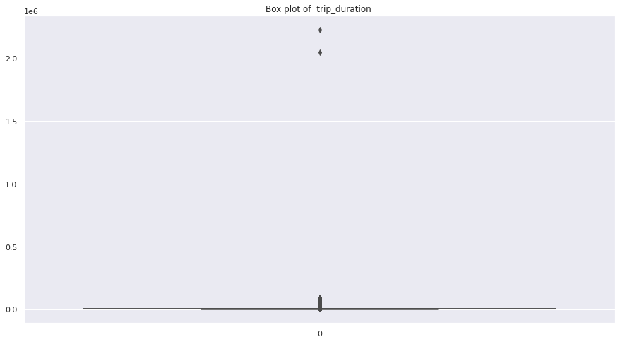
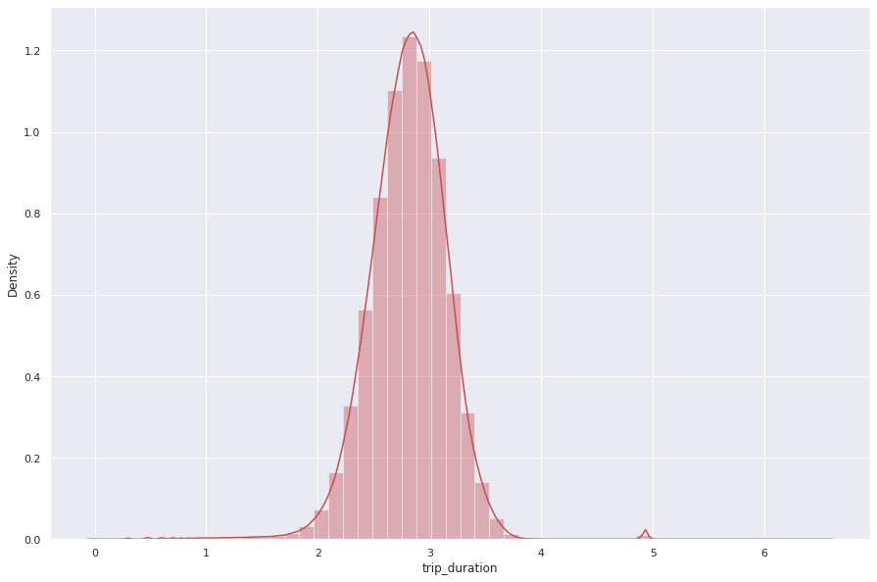
Trip Duration (Dependent Variable ) Data Analysis

Slide 14
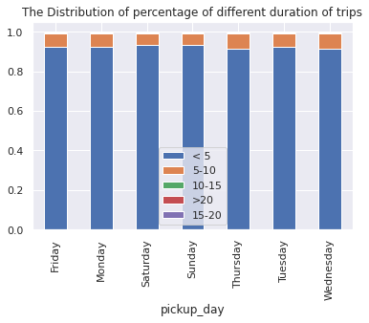
Trip Duration/Day of the Week

Slide 15


Data Analysis Details

Slide 16
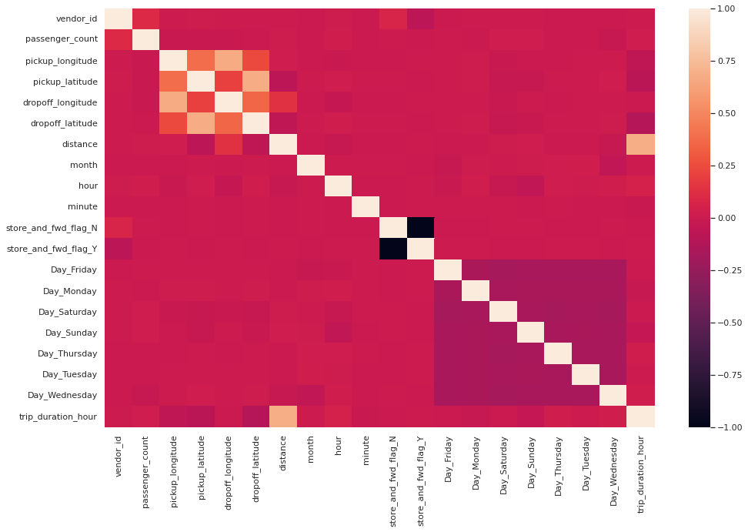
Correlation

Slide 17
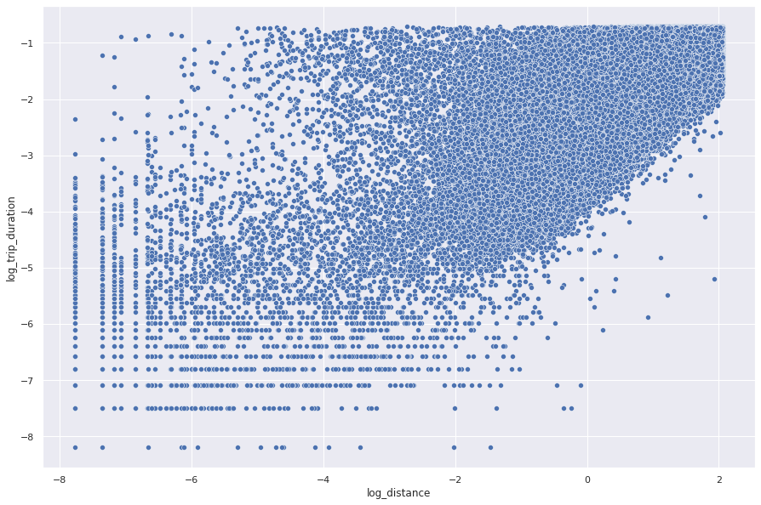
Linear Relationship between Trip Duration & Distance

Slide 18
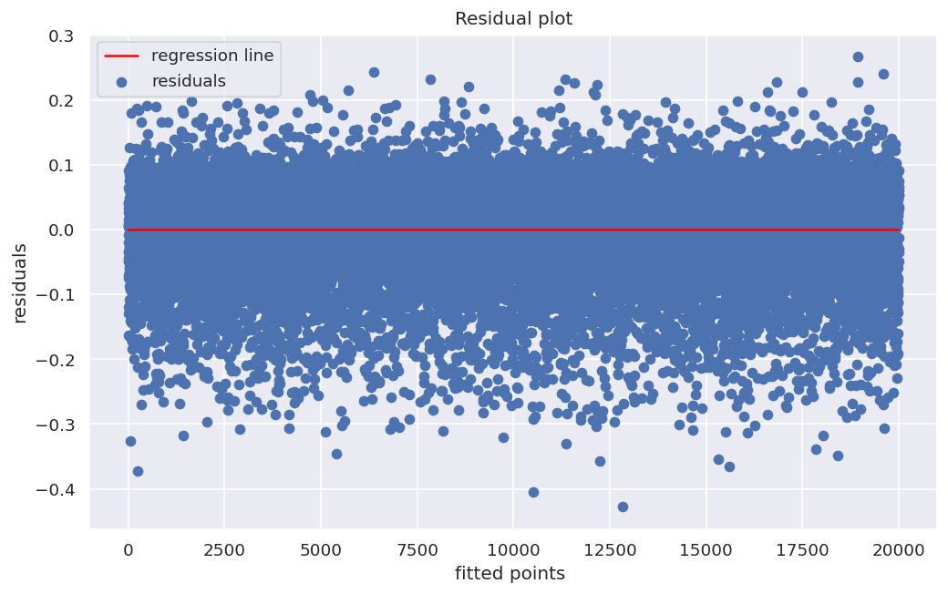
Heteroscedasticity check

Slide 19

Fitting different models
For modelling we tried various Regression algorithms like:
1.Linear Regression
2.Decisoin Tree Regression
3.Lasso Regression
4.Ridge Regression
5.Gradient Boost Algorithm
6.XGBoost Algorithm.

Slide 20


Training and Testing the Data
Training and testing datasets are the two key concepts of machine learning
The training dataset is used to fit the model.
The testing dataset is used to evaluate the model.

Slide 21

Linear Regression
Train Set Metrics :
MSE : 0.005640008417446791
RMSE : 0.07509998946369294
R2 : 0.4874971461304666
Adjusted R2 : 0.4873753962652063
Test Set Metrics :
MSE : 0.005585290140116888
RMSE : 0.07473479872266257
R2 : 0.49033303940382356
Adjusted R2 : 0.4898483711229764

Slide 22
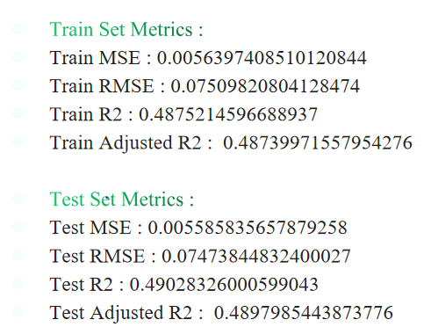
Lasso Regression Ridge Regression
Train Set Metrics :
Train MSE : 0.005639948607174909
Train RMSE : 0.07509959125837443
Train R2 : 0.48750258103991373
Train Adjusted R2 : 0.48738083246576724
Train Set Metrics :
Test MSE : 0.005586654674653299
Test RMSE : 0.07474392734298418
Test R2 : 0.49020852337111
Test Adjusted R2 : 0.48972373668162306

Slide 23
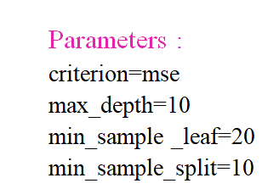
Decesion Tree
Train Set Metrics :
Train MSE : 0.00407420189507022
Train RMSE : 0.06382947512764162
Train R2 : 0.6297806769215077
Train Adjusted R2 : 0.6296927278450075
Test Set Metrics :
Test MSE : 0.004418982852936084
Test RMSE : 0.06647543044566229
Test R2 : 0.5967605078551173
Test Adjusted R2 : 0.5963770468766012

Slide 24
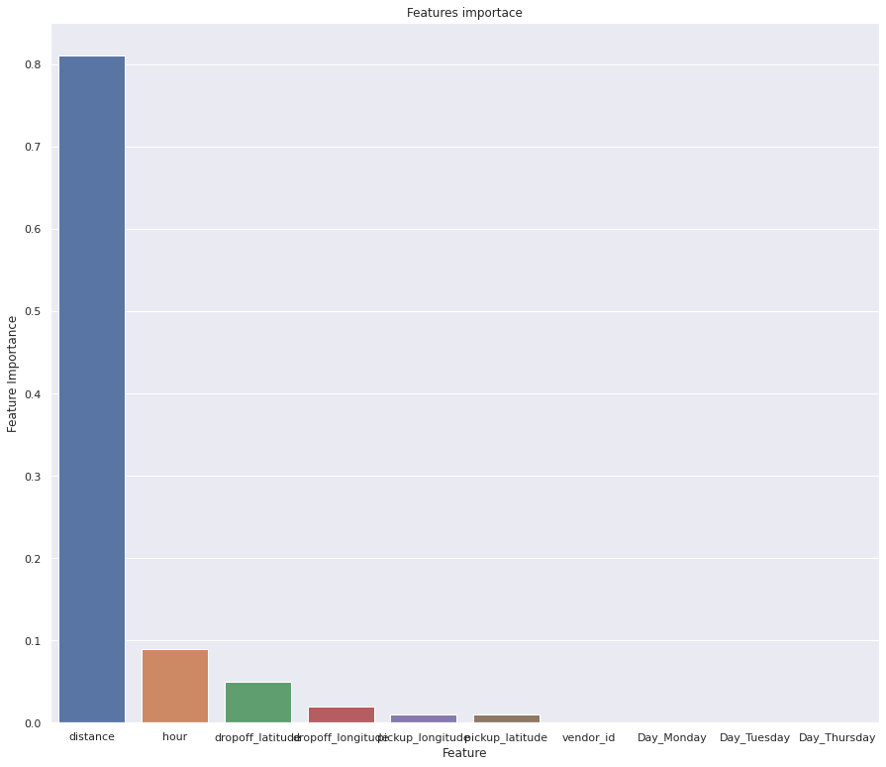
Decision Tree Feature Importance

Slide 25
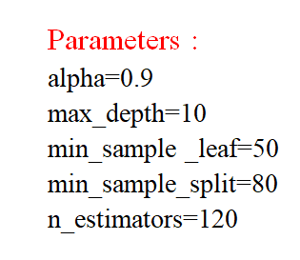
Gradient Boosting
Train Set Metrics :
Train MSE : 0.002464880040148696
Train RMSE : 0.0496475582496128
Train R2 : 0.7760184096331316
Train Adjusted R2 : 0.775965200703187
Test Set Metrics :
Test MSE : 0.0034093138427249174
Test RMSE : 0.058389329870490184
Test R2 : 0.6888944745306078
Test Adjusted R2 : 0.6885986284353166

Slide 26
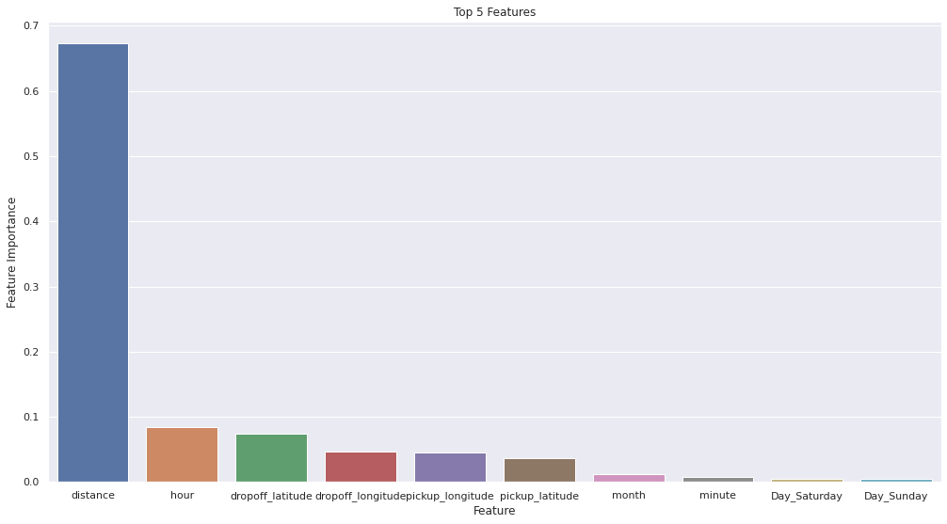
GBoost feature importance

Slide 27
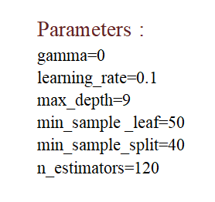
XGBOOST
Train Set Metrics :
Train MSE : 0.0021932242065095587
Train RMSE : 0.04683187169556176
Train R2 : 0.800703548325423
Train Adjusted R2 : 0.8006562035819644
Test Set Metrics :
Test MSE : 0.003418522468085611
Test RMSE : 0.0584681320728276
Test R2 : 0.6880541722399276
Test Adjusted R2 : 0.687757527058374

Slide 28
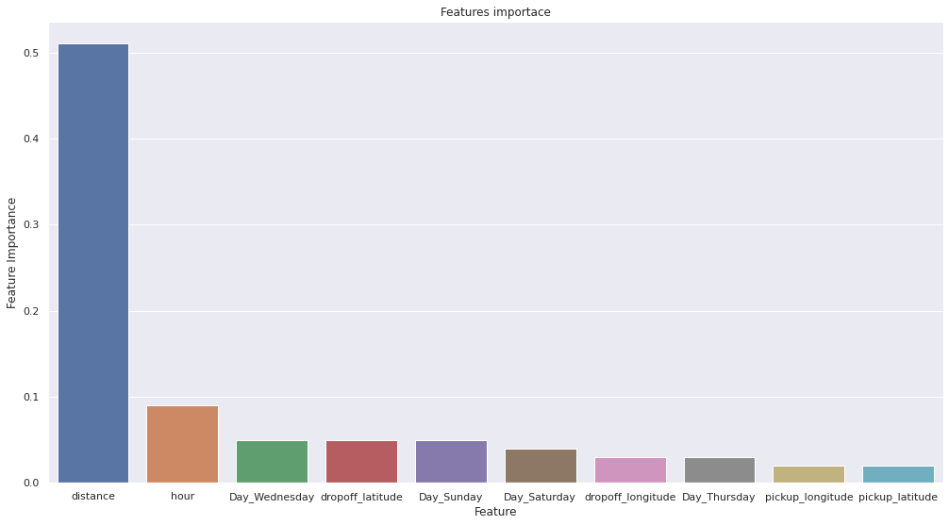
XGBoost feature importance

Slide 29
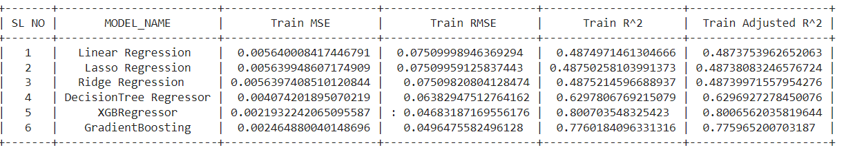
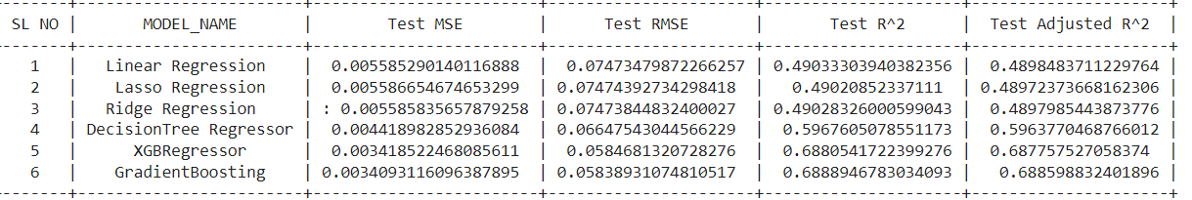
Final metrics conclusion

Slide 30

Challenges
Handling large Data set
Feature Engineering
Computation time
Optimizing the model

Slide 31
Conclusion
1. In this project, we tried to predict the trip duration of a taxi in NYC.
2. We are mostly concerned with the information of pick up latitude and longitude and drop off latitude and longitude, to get the distance of the trip.
3. Gradient Boosting will be the best model to predict the trip duration for a particular taxi.

Slide 32

THANK YOU !!!

